Slide 1
JAVA
Unit 3(c)

Slide 2
Final keyword
https://www.geeksforgeeks.org/final-keyword-java/

Slide 3
Static keyword
To create a static member(block, variable, method, nested class), precede its declaration with the keyword static.
When a member is declared static, it can be accessed before any objects of its class are created, and without reference to any object.
For example, in below java program, we are accessing static method m1() without creating any object of Test class.

Slide 4
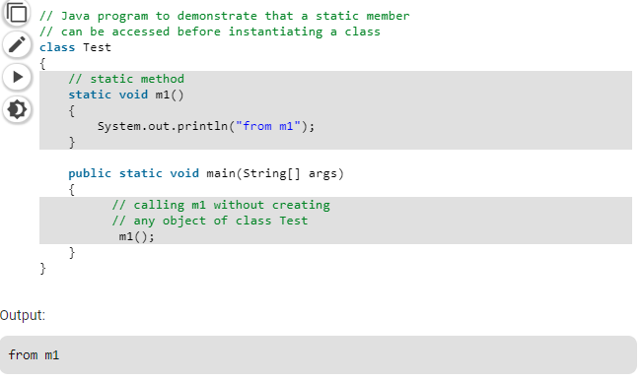
Static methods

Slide 5
Static variable
The static variable can be used to refer to the common property of all objects (which is not unique for each object), for example, the company name of employees, college name of students, etc.
The static variable gets memory only once in the class area at the time of class loading.
It makes your program memory efficient (i.e., it saves memory).

Slide 6
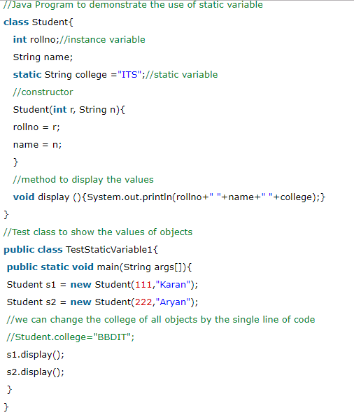
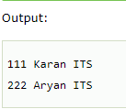
Static variable

Slide 7
Command line arguments
The command line argument is the argument passed to a program at the time when you run it. To access the command-line argument inside a java program is quite easy, they are stored as string in String array passed to the args parameter of main() method.
If we run a Java Program by writing the command “java Hello Geeks At GeeksForGeeks” where the name of the class is “Hello”, then it will run upto Hello. It is command upto “Hello” and after that i.e “Geeks At GeeksForGeeks”, these are command line arguments.
When command line arguments are supplied to JVM, JVM wraps these and supply to args[]. It can be confirmed that they are actually wrapped up in args array by checking the length of args using args.length

Slide 8
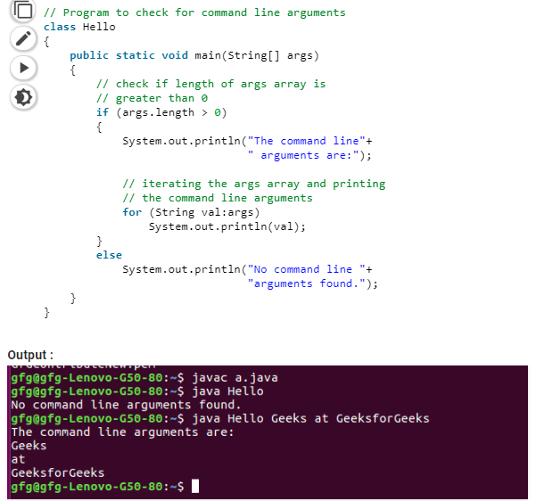

Slide 9
